Slide 1
Numbers in NLP: A Survey
by Bharath Gunasekaran

Slide 2
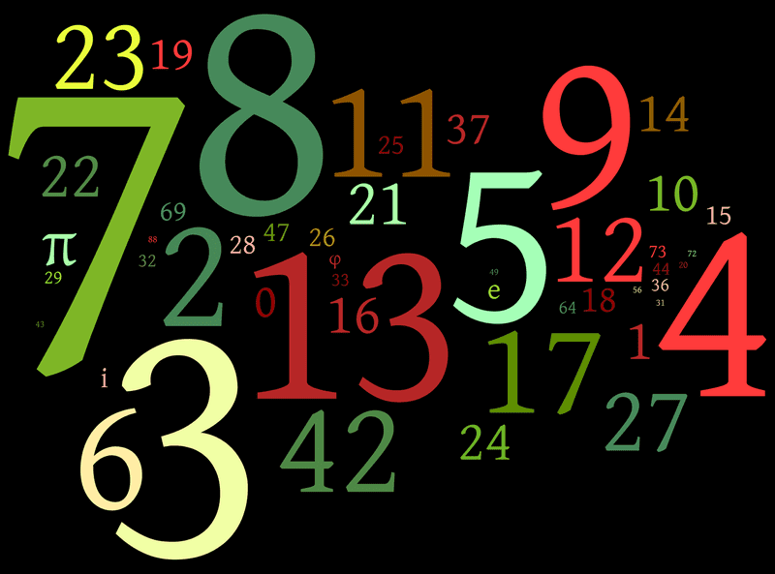
What is Numeracy?
The understanding of numbers and how to use them
Numbers help us understand the world around us.
Numbers are discarded in NLP or treated as words
The human brain represents number and words in different way.
Source: For the Love of Numbers | Radiolab | WNYC Studios

Slide 3
Importance of Numbers
There are 150 million numbers in the 6 million pages of the English Wikipedia.
Consider the following sentences
“I woke up at 11”
Our brain decodes the “11” into a number and denotes it to a time of day. We can conclude waking up 11 is late.
“I earn $11 per month”
“I earn $10 per month”
Sentences are semantically the same, but change in number affect the meaning of the sentence. Context of a number is key to understanding what it signifies.

Slide 4
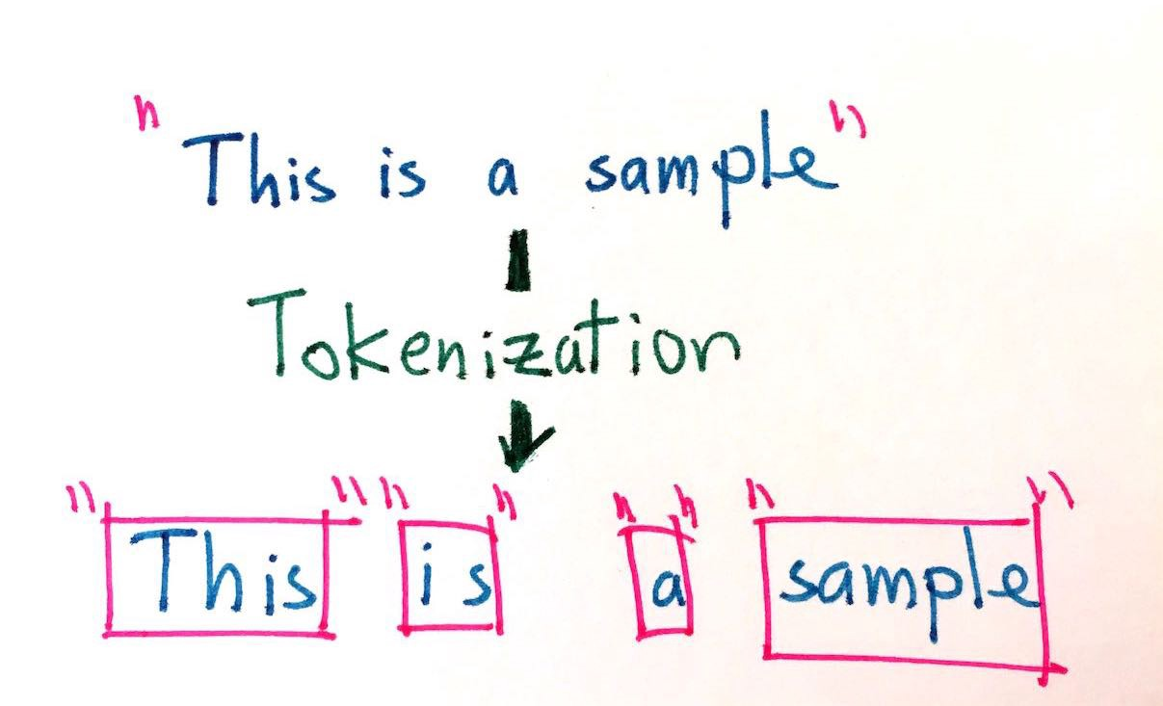
Number in NLP Today
Filtered out during preprocessing
Tokenized into UNK token
Split into arbitrary tokens and diminish the contained information
BERT performs 5 times worse when an answer to a question is a number vs a word.
Source: Tokenization algorithms in Natural Language Processing (NLP) | by Mehul Gupta | Data Science in your pocket | Medium

Slide 5
Numeracy Tasks Categories
Tasks are split into 2 categories
Granularity
Units
Granularity - the encoded number is exact or approximate
exact (ex. birds have two legs)
approximate (ex. The boy is 160 cm tall).
Units - number are abstract or grounded
abstract not unit is specified ex) 5
grounded a unit is specified ex) 1 apple

Slide 6
Numeracy Tasks
Simple Arithmetic: Applying basic arithmetic operation such as addition, subtraction, and ect. over numbers alone
Numeration: Decoding a numerical value from a string ex) “19” can be decoded as 19 or 19.0
Magnitude Comparison: Compare two or more numbers and figure out which is the largest
Arithmetic Word Problems: Similar to math word problem you find in school textbooks.
Exact Facts: The context of the number involves commonsense knowledge. Ex) “A dice has 6 sides” will allow you to know that the statement “a dice has 5 sides” is false.
Measurement Estimation: Trying to approximately guess measurements objects given some dimensions. Ex) How many seeds are in a watermelon
Numerical Language Modeling: Task of making numeric prediction from completely unlabeled data

Slide 7
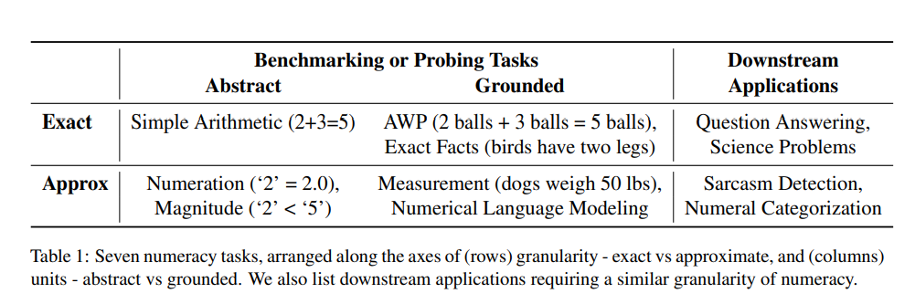
Numeracy Tasks

Slide 8
Number Representation: String Based
String Based Representation - sees numbers as the same words
Possible Improvements:
Notations
changing the representation of a number. ex) decimal to scientific notation
Tokenization
change tokenization to digit or character level
Pooling
used to analyze the effect of tokenization

Slide 9
Number Representation: Real Based
Real Based Representation - used the numerical value of the number to perform some computations
Possible Improvements:
Direction
define if method decodes or encodes the number or applies both
Scale
scaling of a number
Discretization
binning numbers or using continuous values for embedding

Slide 10
String Based Representation Methods
Word Vectors & Contextualized Embedding: Typical NLP method to handle number.
GenBERT: Is a model that is built on top of pretrained BERT but tokenizes numbers at the digit level
NumBERT: Is a model of BERT trained from scratch on a dataset where all number are converted to scientific notation.
DigitRNN, DigitCNN: Is a method that pools single digit embeddings to represent full numbers. Uses RNN and CNN for pooling
DigitRNN-sci, Exponent: Is similar to DigitRNN but uses scientific notation. Exponent embedding learns to do a look up on the exponent.

Slide 11
Real Based Representation Methods
DICE: An encoder that preserve the relative magnitude between two numbers and their embeddings
Log Value: encoding the log-scaled value of the number. There is also a log scaled decoder called RGR.
Log Laplace: a decoder that is log based
Flow Laplace: an expressive decoder that learns its own density mapping. The scaling is learned by the model so it can potential be anything.
MCC (Multi-class classification): A decoder that output values in a log scaled bins of numbers.
Discrete Latent Exponent (DExp): a decoder where the model parameterized a multinomial distribution for an exponent.
GMM: Gaussian mixture model that learns by pre-training on the means and variance over training corpus.
GMM-prototype: Same as GMM but the model learns the prototype embeddings and are encoder only.

Slide 12
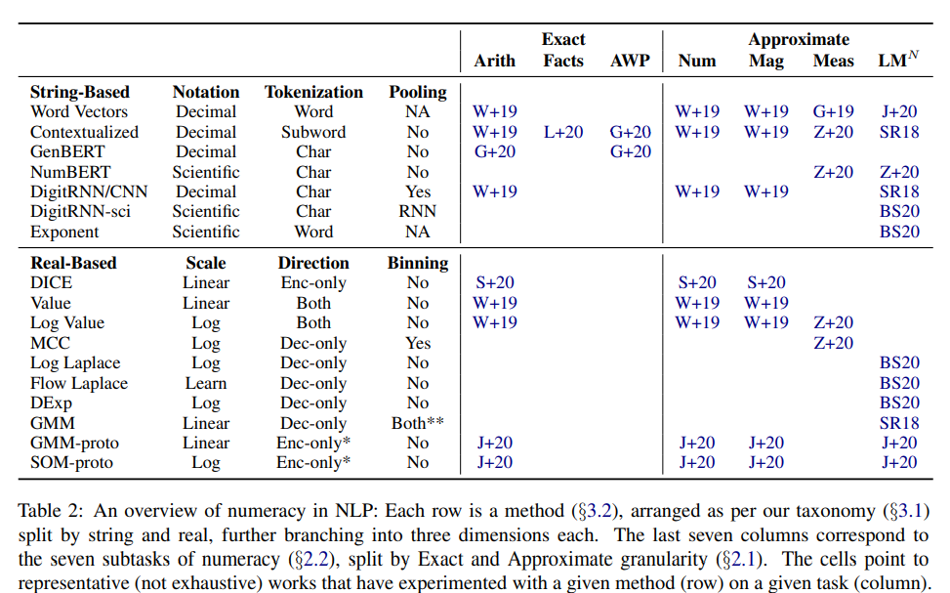

Slide 13
Model Recommendations
For string based representation using scientific notation instead of decimal notation yielded better results.
Character or digit tokenization was better than word or sub-word tokenization.
For real based representation using a log scale vs linear scale improves performance.
Combined with binning increases model performance.
For abstract tasks such as numeration and magnitude comparison DICE, Value and Log embedding perform exceptionally well.
Real based methods work really well on approximation tasks such as measure estimation and language modeling.

Slide 14
Thank you
Referenced Article: “Representing Numbers in NLP: a Survey and a Vision”: https://arxiv.org/pdf/2103.13136.pdf.

